Slide 1

Customer Service Management System
Guided by,
Aliasger Mulla
Presented by,
Veeraballi Sai Prasanna
Bhuvaneswari Eediga Devaraju Gari
Gayathri Gireesh
Ajay Kumar
Hrishikesh

Slide 2
Contents
Introduction
Purpose of CSMS
Data Flow Diagram
Functions
Non-functional Requirements
Conclusion
Advantages of CSM

Slide 3
Introduction to CSMS
●With the help of the Customer Service Management System(CSMS), customer service is connected to support operations on a single platform.
● This gives them visibility into the operational status of customer-facing digital and connected products and services.
● This enables faster issue resolution and more proactive customer service.
● In this project work, we developed a CSMS to define & resolve the issues regarding electronic appliances.
● Here, the database of the customer is managed by Customer Relationship Manager.

Slide 4
Cond...
●The CRM can enter customer details into the database for both new customers and existing customers.
● The CRM is also responsible for modify the database of customer.
● The CRM enters the CSMS by using the username & password.
● If the username or password is invalid CRM can't login to the system.
● The only thing customer can do is raise their complaints, service request, and demo request in the system by using their customer Id.
●Each customer has a unique customer Id and each request has a unique request Id.

Slide 5
Purpose of CSMS
●The purpose of this document is to show the requirements for the Customer Service Management System.
●These systems allows the CRM to add new customers, update the customer details and delete the customer details.
● Each customer can raise requests for service, demo, and complaints with the product they bought.

Slide 6
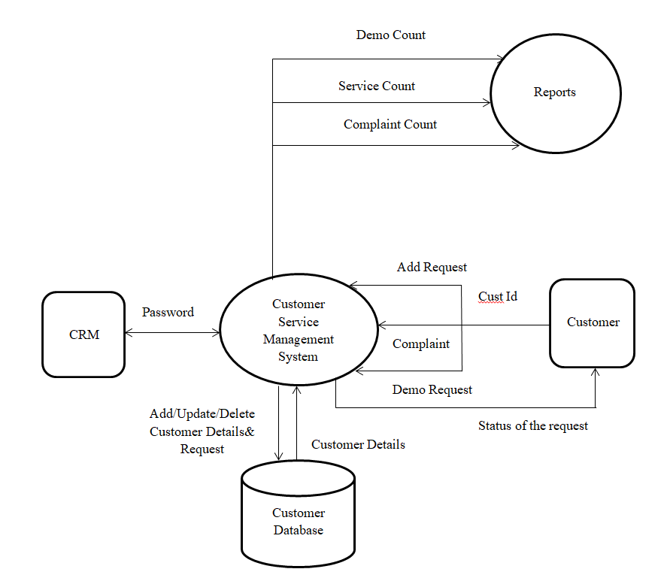
Data Flow Diagram

Slide 7
Advantages of CSM
● CSM provides a service catalog.
● Customers want their requests or issues to be resolved within a timeframe that they consider acceptable.
● CSM solutions empower you to manage customer projects effectively.
● CSM allows organizations to scale customer operations, handling more issues, cases, and support tasks, without demanding more resources.
● CSM systems give you end-to-end case resolution data on a single platform.

Slide 8
Functions
1 crm_menu: This is the menu level function that provides flexibility to enable the CRM to do modifications inside the database. It allows CRM to Add, Update, Delete and Display contents of the database.
2 customer_menu: This is the menu level function is for the customer, there the customer can raise service request, demo request and complaint request.
3 manage_customer: This function is used to add/update/delete any kind of changes into the existing records in the database by the CRM.
4 manage_request: The job of this function is to add/update/delete the requests raised by the customer, which is done by the CRM.

Slide 9
Contd...
4 manage_request: The job of this function is to add/update/delete the requests raised by the customer, which is done by the CRM.
5 view_reports: This function shows total number of complaints that is not addressed the specified date, total number of demos on a given date, total number of service calls closed for a specified customer and service calls closed last month.
6 add_customer: This function is called by the function add_customer(). Here the CRM can add the details about the customer to the database file.
7 update_customer: This function is also called by manage_customer(). Here the CRM can update the details about the customer which is already stored in the database.

Slide 10
Contd...
8 delete_customer: This is the final function called from delete_customer( ). Here the details of the customer are deleted by the CRM.
9 add_request: This a function called by the add_request( ). Here the CRM can add any changes to the request raised by the customer.
10 update_request: This is the used to update the request which is raised by the customer. The updation is done by CRM.
11 delete_request: This function is used to delete the request from the customer side. By using this, the CRM can handle the database more effectively.

Slide 11
Contd...
12 generate_customerId: This function is used to generate customer Id for the newly entering customer.
13 isValidCustId: This function is used to validate whether the customer Id entered by the customer is valid or not.
14 generate_requestId: This function is used to generate request Id for the customer who registering the requests or complaint. 3.1.15 isValidRequestId: This function is used to validate whether the request Id entered by the customer is valid or not
16 isPhoneValid: This function is used to validate whether the phone number entered by the CRM is valid or not.

Slide 12
Contd...
17 isNameValid: This function is used to validate whether the name entered by the CRM is valid or not.
18 isValidPass: This function is used to validate whether the password entered by the CRM is valid or not.
19 demo: This function will contain the demo date, address of the customer, and suitable time for demo.
20 complaint: This function will contain the category, sub category and description about the complaint.
21 service: This function will contain AMC date & duration, product name &purchased date.

Slide 13

Non-Functional Requirements
● Makefile:- It is a way of automating software building procedure and other complex tasks with dependencies.
● It is a set of commands with variable names and targets to create object file and to remove them.
Makefile Link : https://github.com/AjAy0301/Customer-Service-Management-System/blob/master/CUT/Code/compile/Makefile
● Valgrind:- To detect memory leaks.
Valgrind Link :

Slide 14
Conclusion
●These systems allows the CRM to add new customers, update the customer details and delete the customer details.
● Each customer can raise requests for service, demo, and complaints with the product they had bought.
● The system generates a report which shows total number of complaints that are not addressed on the specified date, the total number of demos on a given date, l number of service calls closed for a specified customer and service calls closed last month.

Slide 15

Github link:
https://github.com/AjAy0301/Customer-Service-Management-System

Slide 16

Thank You....

